Slide 1
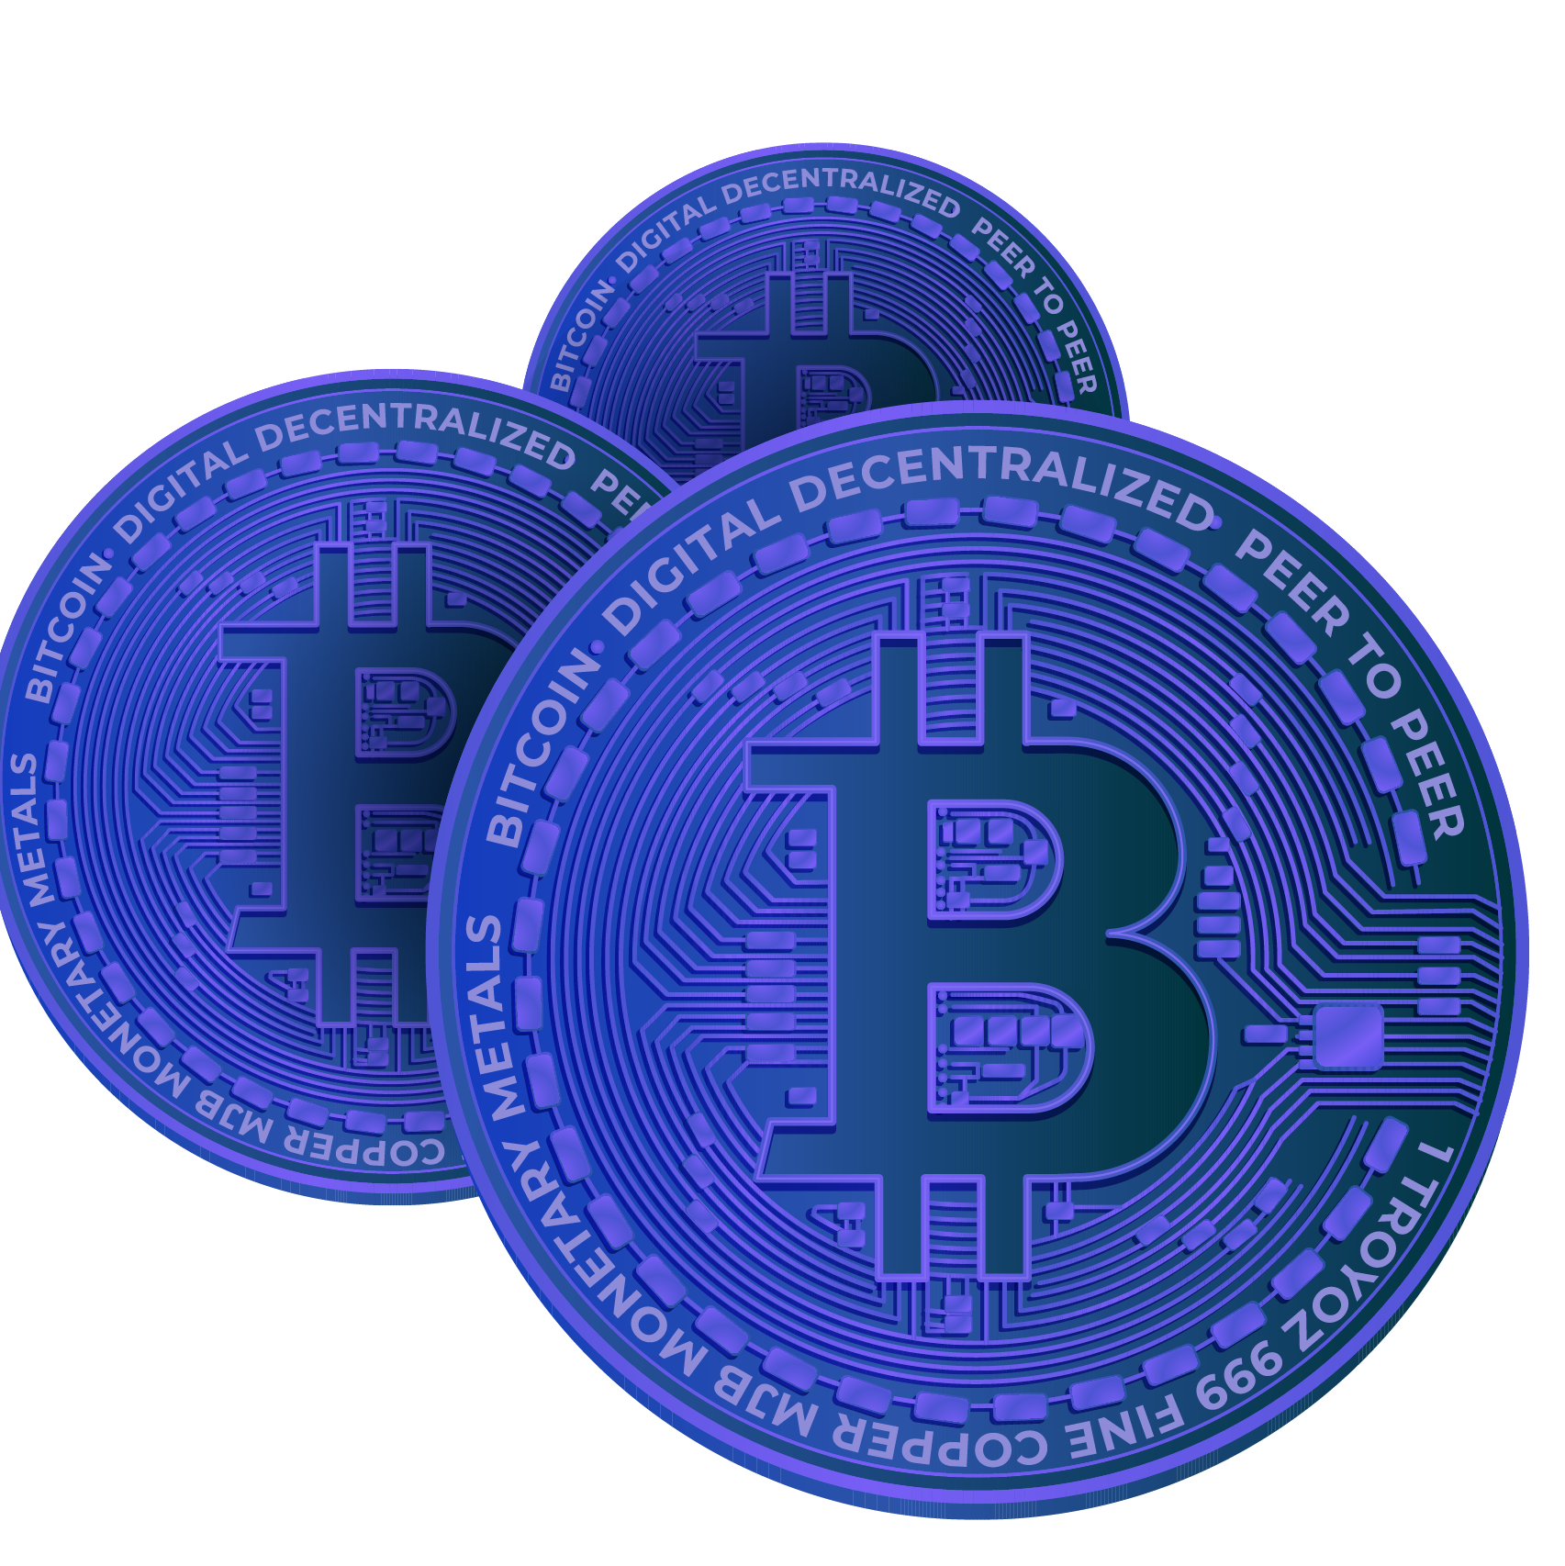
Blockchain Lottery System: Decentralized, Fair, and Transparent
Team Members: Amogh Sadvelkar - 129 Srushti Surve - 117
Notes:
1. Table of contents
2. Introduction
3. Our company
4. Our team
5. Problem
6. Them vs. us
7. Solution
8. SWOT analysis
9. Product overview
10. Our plans
11. Product demo
12. Traction
13. Case study
14. Reviews
15. Awards
16. Market size
17. Target
18. Competitors
19. Business model
20. Timing
21. Predicted growth
22. Investment

Slide 2
Introduction
Traditional Issues:
Highlight problems in regular lotteries: lack of fairness, transparency, and trust.
Blockchain Solution:
Introduce blockchain as the solution to these issues.
Explain Ethereum and its smart contract capabilities.
Our Innovation:
Present our decentralized lottery system using Ethereum.
Emphasize fairness, transparency, and trust as our core principles.
Presentation Preview:
Briefly outline what the audience can expect: how our system works, its benefits, and real-world examples.
Impact Statement:
Explain the importance of fair lotteries in society.
Set the stage for the rest of the presentation, highlighting the transformative impact of our blockchain lottery system.

Slide 3
Technology Used
Ethereum Blockchain:
Foundation of our system, providing security and transparency.\
Solidity Smart Contracts:
Programmed using Solidity language for automated, tamper-proof processes.
Decentralized Apps (DApps):
User interfaces designed as DApps for seamless participant interaction.
Random Number Generator (RNG):
Utilizes RNG algorithms to ensure fair and unpredictable winner selection.
MetaMask Wallet:
Integration with MetaMask for secure and convenient fund transfers and interactions.

Slide 4
Problem Statement
Lack of Fairness:
Traditional lotteries often favor certain players, raising concerns about fairness.
Transparency Issues:
Results and selection process are not transparent, leading to distrust among participants.
Middlemen Costs:
Involvement of intermediaries increases costs, reducing the prize pool for winners.
Delayed Payouts:
Winners face delays in receiving their prizes due to manual verification processes.
Trust Deficit:
Widespread distrust in traditional lotteries due to these issues, hindering participation.

Slide 5
How it works
1. Participants Join:
Easy registration for participants.
2. Manager Picks a Winner:
Random winner selection via smart contract.
3. Winner Takes All:
Instant transfer of the entire prize.
4. Transparency Ensured:
Every step visible on the blockchain.
5. User-Friendly:
Intuitive interface for all users.
6. Trustworthy System:
Builds trust through fairness and transparency.

Slide 6
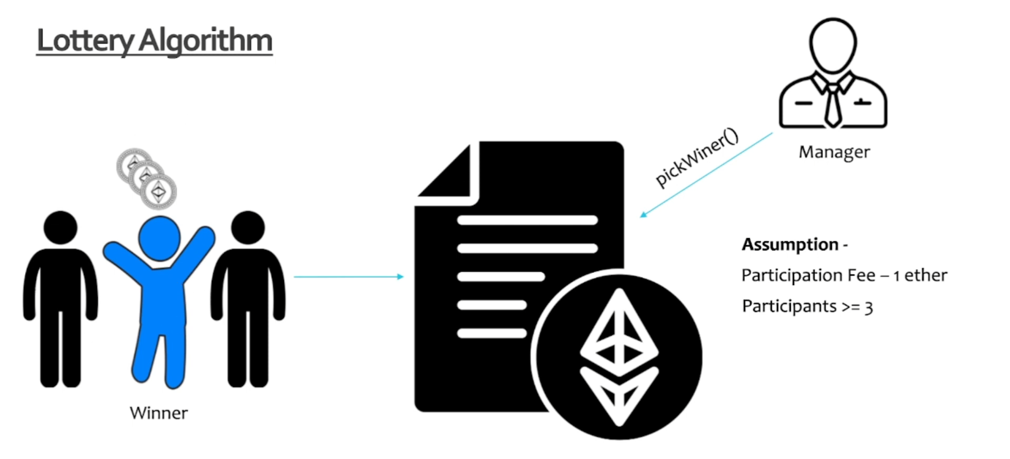
Methodology

Slide 7
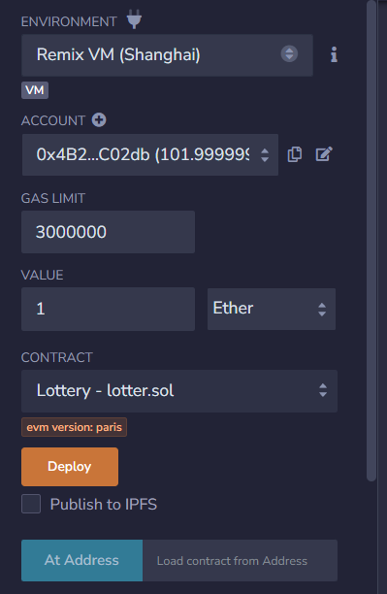
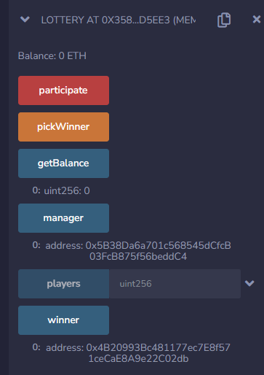
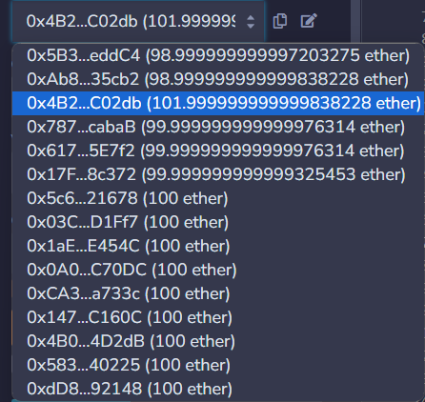
Output

Slide 8
Thank you

